Slide 1



HACKINDIA HACKATHON
2025
TEAM NAME :
CHAOS
TEAM MEMBERS :
ROHIT KUMAR (LEAD)
AMAN SONWANI
SINTU HAZARIKA
UNIVERSITY :
UTD Chhattisgarh Swami Vivekanand Technical University ,Bhilai ,Chhattisgarh

Slide 2


Problem Statement
Traffic congestion is a major urban challenge, leading to delays, pollution, and inefficient emergency response.
Conventional traffic lights operate on fixed timers, causing unnecessary waiting and fuel wastage.
Emergency vehicles get stuck in traffic, delaying critical response times.
Our goal is to create a smart, decentralized, and AI-driven solution that adapts to real-time traffic conditions

Slide 3


Our Solution
AI-Based Smart Traffic Light System
Technologies stacks Required,
Cameras & Sensors: To detect vehicles at intersections.
AI Model (YOLO or OpenCV-based detection): Identifies vehicles in real-time.
Microcontroller (Raspberry Pi/Jetson Nano/Arduino with Edge AI): Processes the data.
Traffic Light Control System: Adjusts the signals based on detected traffic.
IoT Integration (Optional): For data logging and cloud-based monitoring.

Slide 4
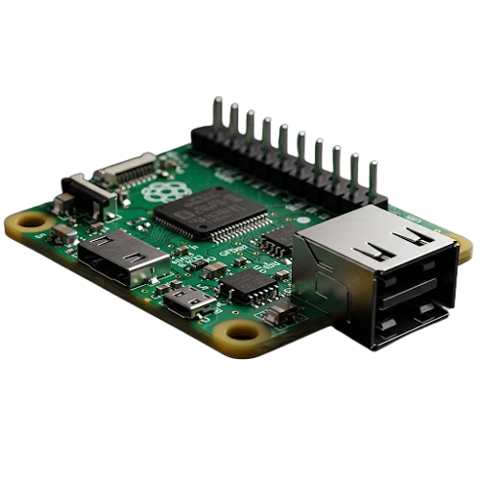



Implementation
🔹 Software & AI Technologies
AI Model YOLO (You Only Look Once) / OpenCV
Programming Languages: Python, C++
Cloud & IoT: Google Firebase / AWS IoT, MQTT Protocol
Automation & Control: Arduino IDE, Node-RED
🔹 Hardware Components
AI Camera & Sensors (OpenCV-compatible)
Specialized chipsets to perform real time rendering of uniquely identified objects.

Slide 5
How AI Works
Real-Time Data Collection: Leverage IoT sensors, GPS apps, and connected devices at intersections to gather live traffic data.
Data Preparation: Clean and normalize the data for reliable analysis.
Predictive Analysis: Apply machine learning to identify congestion patterns using historical and real-time data.
Smart Optimization: Use AI algorithms (e.g., reinforcement learning or dynamic programming) to determine optimal signal timings.
Dynamic Adjustments: Monitor traffic flow continuously and adjust green-light durations in real time via edge computing.
Secure Integration: Store traffic data and AI decisions on decentralized Web3 platforms for transparency and security.

Slide 6

System Architecture
Start
Data Collection
Data Preprocessing
Traffic Pattern Analysis
Optimization Model
End
Real-Time Decision Making
Feedback Loop
Web3 Integration

Slide 7
Benefits
Reduces Fuel Waste – Stops unnecessary idling, saves petrol/diesel/gas.
Decreases Air Pollution & Global Warming – Lowers CO₂ emissions, improves
air quality.
Saves Time & Improves Traffic Flow – Reduces congestion and waiting time.
Prioritizes Emergency Vehicles – Detects ambulances/fire trucks for priority passage.
Smart City Integration – Connects with IoT for real-time monitoring.
Economic Benefits – Reduces fuel costs for drivers and traffic management expenses.
Energy-Efficient Traffic Management – Can integrate with solar-powered traffic lights.

Slide 8

Conclusion
💡 Real-Time Traffic Management: Reduces unnecessary stops.
♻ Eco-Friendly: Decreases CO₂ emissions and air pollution.
⏳Saves Time: Faster movement of vehicles.
⛽ Reduces Fuel Waste: Saves petrol, diesel, and gas.
🚑 Emergency Vehicle Priority: AI detects ambulances and gives them green signals.
📊 Smart City Integration: Can be connected to IoT and cloud-based monitoring

